Slide 1
BITS Pilani presentation
K.Anantharaman
kanantharaman@wilp.bits-pilani.ac.in
04/11/23
SE ZG544-S1-23-24 Agile Software Process

Slide 2
Module-10 – Managing Quality and Risks in Agile Project
04/11/23
SE ZG544-S1-23-24 Agile Software Process

Slide 3
Key Differences between Agile and Traditional Quality Management
Integration of Testing with Development
Concurrent vs Sequential
Testing Approach
More reactive vs More Proactive
Responsibility of Quality
Overall Team <> QA Team
Regression testing
Frequent (Code Changes), At end after Code stabilizes
04/11/23
SE ZG544-S1-23-24 Agile Software Process

Slide 4
Agile Development and Testing Practices
Agile Development Practices
Continuous Integration
Code Refactoring
TDD
Pair Programming
Agile Testing Practices
Repeatable Test Automation, Acceptance Drive test development
Exploratory testing, Concurrent Testing, Value & Risk based testing
04/11/23
SE ZG544-S1-23-24Agile Software Process

Slide 5
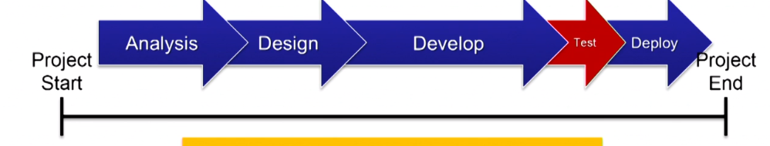
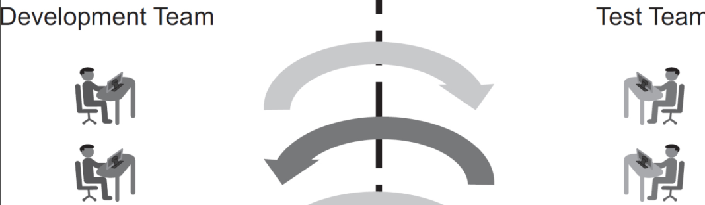
Agile Approach to Quality
Water fall Project
Agile approach to building quality product
Early delivery & Testing, Sprint Review, Customer feedback
Customer collaboration
Good Technical practices
Whole team participation to Quality
Test Automation
Ref: https://www.vivifyscrum.com/insights/qa-agile-project-management
04/11/23
SE ZG544-S1-23-24 Agile Software Process

Slide 6
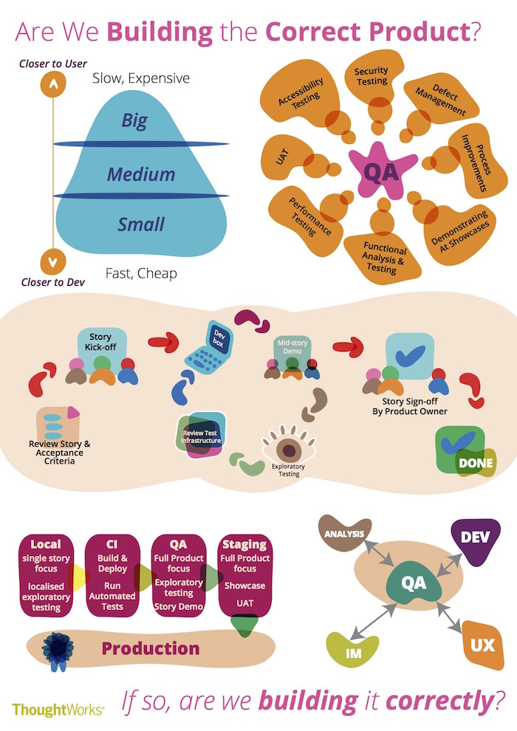
QA Role in Agile Project
Agile/Scrum: QA is involved in every aspects of Project/Product development cycle
QA has a unique mix of all these capabilities.
QA brings the mindset of "Are we building the correct product and, if so, are we building it correctly?"
04/11/23
SE ZG544-S1-23-24 Agile Software Process
https://www.thoughtworks.com/insights/blog/qa-role-what-it-really

Slide 7
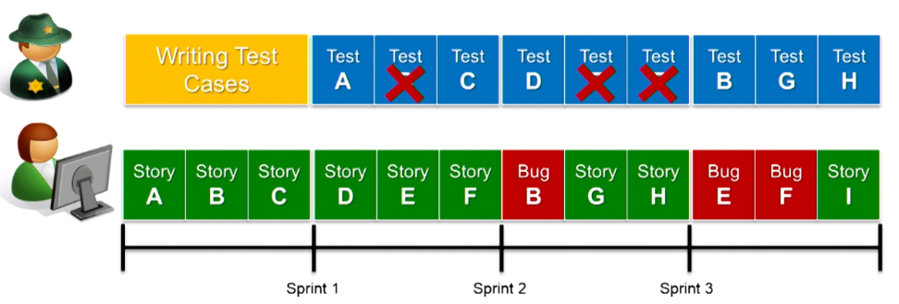
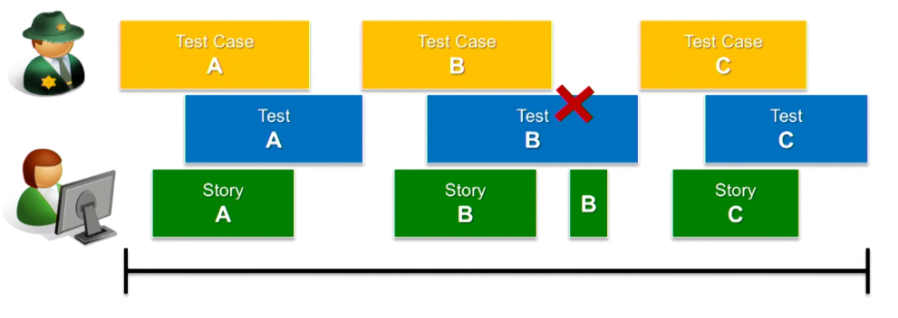
Testing within Sprint
QA
QA lagging behind in Testing
Bugs Snowballing effect
Dev
Collaboratively testing with Dev.
Fully tested Software
Minimal Hands-off.
QA
Dev
Dealing with bugs:
Critical, Non-Critical, Enhancements
04/11/23
SE ZG544-S1-23-24 Agile Software Process
Source: Scrum Fundamentals and Advanced by Tommy Norman, Published by Addison-Wesley Professional 201

Slide 8
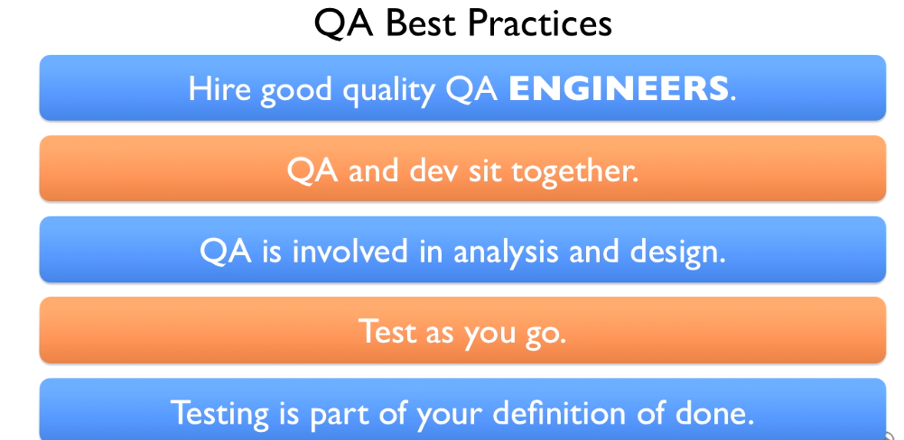
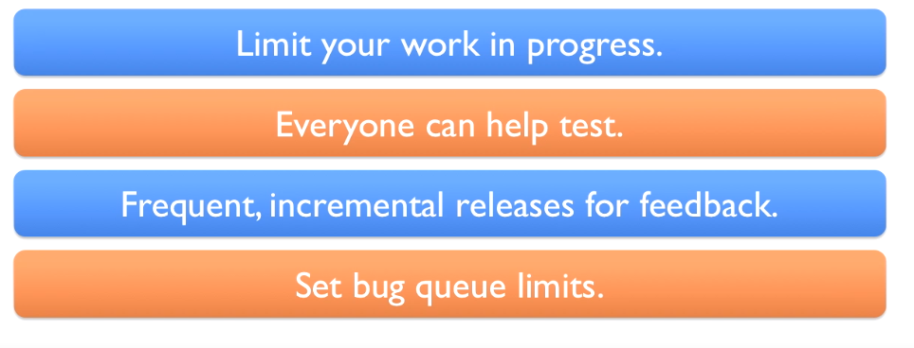
QA good Practices
Process Quality
Product Quality
Don’t Accumulate defects
Source: Scrum Fundamentals and Advanced by Tommy Norman, Published by Addison-Wesley Professional 201
04/11/23
SE ZG544-S1-23-24 Agile Software Process

Slide 9
Quizes
Q1,Q2,Q3
04/11/23
SE ZG544-S1-23-24 Agile Software Process

Slide 10
Risk Management in Agile
04/11/23
SE ZG544-S1-23-24 Agile Software Process

Slide 11
Risk management in Agile
Risks are uncertain event(s)
May affect your project positively or negatively
Positive Risk: A technology currently being developed that will save you time if released.
Negative Risk: Unavailability of Skilled resources.
Agile methods have a built-in risk mitigation component.
Identify, Assess, Prioritize, Mitigate, Communicate
Daily meeting, Sprint review, Story Grooming, Retrospective
04/11/23
SE ZG544-S1-23-24 Agile Software Process

Slide 12
Mitigation Strategies for positive risks or opportunities
Exploit:
This strategy ensures that opportunity definitely happens. For example, assigning the most talented resource to your project to reduce the duration of the project.
Share:
Allocating part of the ownership of opportunity to a third party to ensure that the opportunity definitely happens and risk is reduced. For example, going for a joint venture.
Enhance:
This strategy increases the positive impact of the opportunity. For example, adding more buffer resources to an activity to finish it early.
04/11/23
SE ZG544-S1-23-24 Agile Software Process

Slide 13
Mitigation Strategies for Negative Risks (Threats)
Avoidance:
Eliminating a specific threat by eliminating the cause.
Use different set of tools/Libraries
Transference:
Contracting, insurance warranties, guarantees, outsourcing the work are the examples of risk transfer.
Mitigation:
Reducing risk probability and impact
Insufficient server resource: Increase CPU/Memory to reduce server crash
Accept:
Accept the risk. Do not do anything.
Taking a risky project with potential for future benefits.
04/11/23
SE ZG544-S1-23-24 Agile Software Process

Slide 15
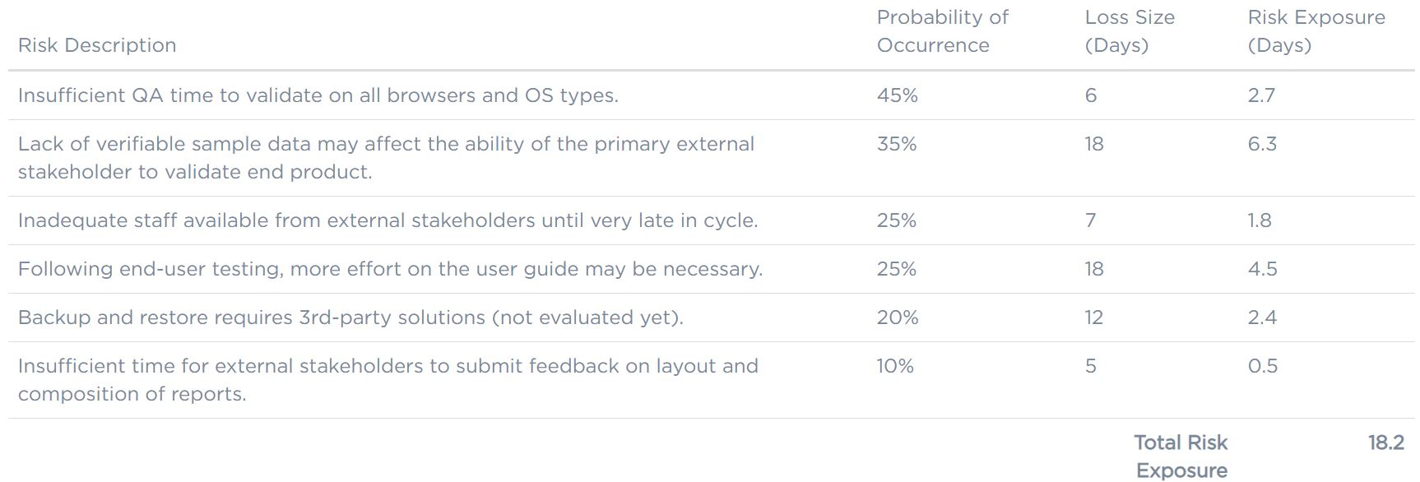
Communicating - Risk Register – An Example
Impact
Risk Impact : Measure the negative impact of the risk.
Risk Impact Objectives: Cost, Time, Quality, Scope
The could be many other columns in the risk register such Date, Owner, Status, Priority etc..
Risk Exposure: Probability * Impact
Source: https://www.castsoftware.com/research-labs/software-development-risk-management-plan-with-examples
04/11/23
SE ZG544-S1-23-24 Agile Software Process

Slide 16
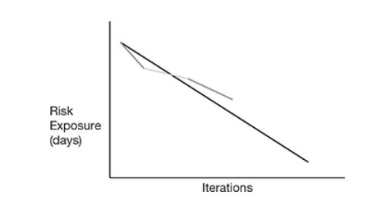
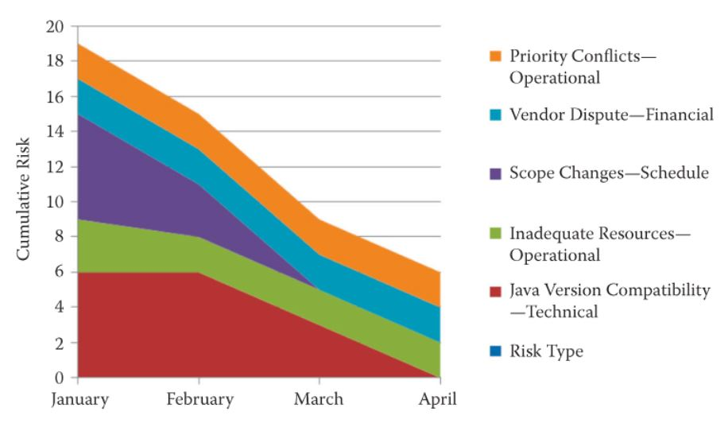
Risk burndown chart
We can draw risk burn-down chart (graph) which contains iterative cycle number vs risk exposure days. Risks are monitored by the use of information radiators, daily stand-up meetings, and iterative cycle reviews and retrospectives. Y-axis of the risk burn-down chart contains risk exposure days. The X-axis of the risk burn-down chart contains the iterative number.
04/11/23
SE ZG544-S1-23-24 Agile Software Process

Slide 17
Use Risk Management to Make Solid Commitments to executives
Use Risk Multiplier in your estimation forecast
Account for common risks - Turnover, Changing Requirements, Work disruption etc..
Risk Multiplier
Chance | Rigorous Process | Risky Process | Description
10% | 1 | 1 | Ignore--almost impossible
50% | 1.4 | 2 | Stretch goal--50/50 chance
90% | 1.8 | 4 | Commitment--virtually certain
*these multipliers are estimates gleaned from DeMarco & Lister's RISKOLOGY simulator and Todd Little's detailed analysis of hundreds of projects. The most accurate approach is to calculate your own risk multipliers from past project history.
Source: https://www.jamesshore.com/v2/blog/2008/use-risk-management-to-make-solid-commitments
04/11/23
SE ZG544-S1-23-24 Agile Software Process

Slide 18
Using risk multiplier in your estimation
For example, if you are using a rigorous approach, your release is 12 iterations away, your velocity is 14 points, and your risk exposure is one iteration.
You would calculate the range of possibilities as:
Iteration remaining = 12-1 = 11
Points remaining = 11 × 14 = 154 points
Risk Multiplier* = 1,1.4,1.8 for Rigorous Approach, Risky Approach = 1,2,4
10 % chance: 154/1 = 154 points
50 % chance: 154/1.4 = 110 points
90 % chance: 154/1.8 = 86 points
In other words, when it is time to release, you are 90% likely to have finished 86 more points of work, 50% likely to have finished 110 more points, and only 10% likely to have finished 154 more points.
04/11/23
SE ZG544-S1-23-24 Agile Software Process

Slide 19
An Example
Suppose, estimated number of sprints is 10 for a release
Product Backlog at end of Sprint 5 - F1,F2,F3,F4,F5,F6
Assume each feature size = 20, Velocity = 20
Total size of the remaining features = 6*20= 120 points
Sprint Remaining = 5, Risk Multiplier = 1,1,4,1.8
6th Sprint Commitments:
10% Chance : Sprint remaining * Velocity - 5*20/1 = 100 points
10% chance of delivering F1,F2,F3,F4,F5 (100 points)
50% Chance : 5*20/1.4 = 71.4 points
50% chance of delivering F1,F2,F3 (60 points), Stretch = F4
90% Chance : 5*20/1.8 = 55,5 points
90% chance of delivering F1,F2 (40 points), Stretch = F3
Repeat this process after completing Sprint6
04/11/23
SE ZG544-S1-23-24 Agile Software Process

Slide 20
Summary
Agile Quality Management
Adaptive planning, Frequent reviews
Concurrent Regression testing
Test Automation
Proactive testing, Defect handling
QA Ownership, QA role is much larger compared waterfall method
Agile Risk Management
Continuous risk assessment: Through daily standup meetings, Scrum planning meeting, release planning meeting, etc.
Agile projects have its own inbuilt risk handling mechanism, well aligned with quick risk identification, Ownership, and controlling mechanism.
The iterative nature of Agile projects identifies risks earlier in the project execution and also the risk process repeats for each and every iteration, thereby managing it in a better way.
04/11/23
SE ZG544-S1-23-24 Agile Software Process

Slide 21
You are faced with three investment options, each requiring an upfront cost of $20,000. The success probabilities and potential returns for each investment are as follows:
Option X: There is a 70% chance of success, which would result in a return of $50,000.
Option Y: There is an 85% chance of success, with a return of $30,000.
Option Z: There is a 60% chance of success, leading to a return of $70,000.
To assess these investment options while considering the impact of uncertainty, calculate the Expected Monetary Value (EMV) for each option. EMV is calculated as the probability of success multiplied by the potential return. Based on your EMV calculations, which investment option appears to be the most economically favorable, taking into account both the likelihood of success and potential returns?

Slide 22
To determine which investment option is better, you can calculate the Expected Monetary Value (EMV) for each option. EMV considers both the probability of success and the potential returns.
Using the information provided:
Option X:
Probability of success (P) = 70% or 0.70
Potential return (R) = $50,000
EMV for Option X = P x R = 0.70 x $50,000 = $35,000
Option Y:
Probability of success (P) = 85% or 0.85
Potential return (R) = $30,000
EMV for Option Y = P x R = 0.85 x $30,000 = $25,500
Option Z:
Probability of success (P) = 60% or 0.60
Potential return (R) = $70,000
EMV for Option Z = P x R = 0.60 x $70,000 = $42,000
Comparing the EMVs:
Option Z has the highest EMV of $42,000.
Option X follows with an EMV of $35,000.
Option Y has the lowest EMV of $25,500.

Slide 23
Quizes
Q4,Q5,Q6,Q7,Q8
04/11/23
SE ZG544-S1-23-24 Agile Software Process

Slide 24
Additional notes – Quality & Risk management
15/5/22
SE ZG544-S1-23-24 Agile Software Process

Slide 25
Issues with Traditional Approaches to Quality Management
Traditional Approach to QA
1. QA Audit for compliance Review
2. Most QA Testing happens at the end
2. Transfer of responsibility from developer to tester and vice versa
In traditional sequential, All of this ‘back and forth’ activity can easily create division within software development and QA teams if not managed correctly.
Ref: https://www.vivifyscrum.com/insights/qa-agile-project-management
04/11/23
SE ZG544-S1-23-24 Agile Software Process

Slide 26
Agile Approach to Quality Management
Agile Manifesto & Agile Principles – Focus on Building Quality In
Early delivery & Testing of working software to customers as quickly as possible.
Customers can also provide early feedback on features, elements in the product which they like/dislike, and aspects of the solution that they wish to remove or modify.
Agile values promotes collaboration with customer, Team works with business team on daily basis, Simplicity, Technical excellence, Daily meetings, iteration feedback
Good Technical practices improves Quality: (Not specific to Agile)
TDD, CI, Collective code ownership, Pair programming, Refactoring, exploratory testing, reviews.
Whole team approach to Quality
In this way, Agile development can improve customer satisfaction and produce solutions that more closely meet customer needs.
04/11/23
SE ZG544-S1-23-24 Agile Software Process

Slide 27
Agile Approach to Quality Management ….
The hand-offs between programmers and testers (if they exist at all) will be so small as not to be noticeable.
Team work, Doing a little of everything (designing, coding, testing, and so on) all the time helps teams work together.
Tester creates automated tests and the programmer programs. When both are done the results are integrated. Hands-off is insignificant.
There should be as much test activity on the first day of a sprint as on the last day
No distinct analysis, design, coding, or testing phases within a sprint. Testers (and programmers and other specialists) are as busy on the first day of a sprint as they are on the last.
For example, testers may be specifying test cases and preparing test data on the first day and then executing automated tests on the last, but they are equally busy throughout.
04/11/23
SE ZG544-S1-23-24 Agile Software Process

Slide 28
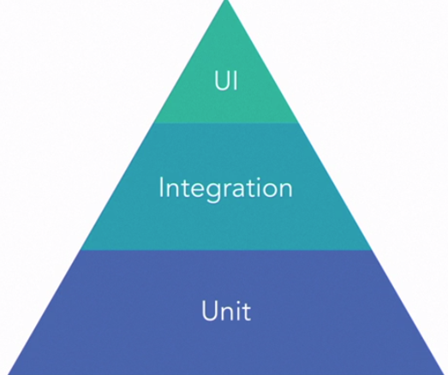
Agile Approach to Quality Management …. Automate Tests at Different Levels
Automation Pyramid
Visual representation of the recommended amount of test coverage that should exist across each type of test.
At minimum we should have three type of automated tests. Depending upon the project type we can have more type of tests
Test Coverage
Slow, Costly
Uniit Test: Isolated tests , test functions, Fast, Need greater number of tests.
Integration tests: Slower, tests interfaces, databases, file system, other applications.
UI Tests: Tests end-end work flow. Much slower.
Medium, Service level
Dev, Fast, Cheap
04/11/23
SE ZG544-S1-23-24 Agile Software Process

Slide 29
The Role of Manual Testing
It is impossible to fully automate all tests for all environments. Further, some tests are prohibitively expensive to automate. Many tests that we cannot or choose not to automate involve hardware or integration to external systems.
Exploratory testing
Free form manual testing, Quick Test planning, test design test execution sessions.
Can identify missing test cases
Exploratory testing can uncover ideas that are missing from the user story as initially understood.
Automate within sprint (Automation not optional)
Pay off Technical debt
04/11/23
SE ZG544-S1-23-24 Agile Software Process

Slide 30
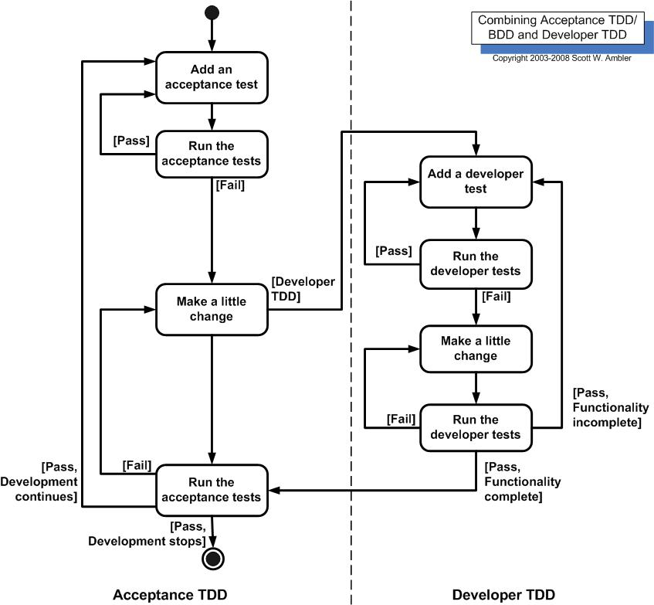
Do Acceptance Test Driven Development
Analogous to test-driven development, Acceptance Test Driven Development (ATDD) involves team members with different perspectives (customer, development, testing) collaborating to write acceptance tests in advance of implementing the corresponding functionality.
04/11/23
SE ZG544-S1-23-24 Agile Software Process

Slide 31
What is Risk?
A risk is considered to be an uncertain event(s) that has the potential to contribute to the success or failure of a project.
Positive risks are defined as opportunities and threats are risks that can affect the project in a negative way.
Examples:
Positive Risk: A technology currently being developed that will save you time if released.
Negative Risk: Unavailability of Skilled resources.
Risk Management
Identify, Assess, Prioritize, Mitigate, Communicate
Agile methods have a built-in risk mitigation component.
Risk Burndown Chart – For communicating the risks
04/11/23
SE ZG544-S1-23-24 Agile Software Process

Slide 32
Mitigating Risks with Agile Methods
The flexibility of agile methods automatically reduces risk in the business environment.
Risk is mitigated because agile methods are flexible with adding or changing user requirements at any time in the project.
Missing or forgotten requirements can be included as soon as they are identified.
This results in low costs associated with managing this category of risks.
Regular feedback reduces risk-related expectations.
As a result of the iterative nature of agile methods, there is adequate time to get feedback and establish expectations during the life cycle of the project.
Stakeholders and the agile team can avoid surprises because of requirements that have been communicated inadequately.
04/11/23
SE ZG544-S1-23-24 Agile Software Process

Slide 33
Mitigating Risks with Agile Methods ….
Agile team ownership supports reduced estimation risk.
When the agile team takes responsibility for estimates of backlog items, this leads to increased accuracy of the estimates that they provide which in turn results in the timely delivery of the product.
Transparency is a risk reducer of undetected risk.
As a result of transparency, risks are always detected and addressed as early as possible.
This leads to better risk management and mitigation. During daily meetings, obstacles are communicated on a regular basis.
Iterative delivery causes a reduction in investment-related risk.
As value is being continuously delivered through the iterations, investment risk is automatically reduced for the end customer.
04/11/23
SE ZG544-S1-23-24 Agile Software Process

Slide 34
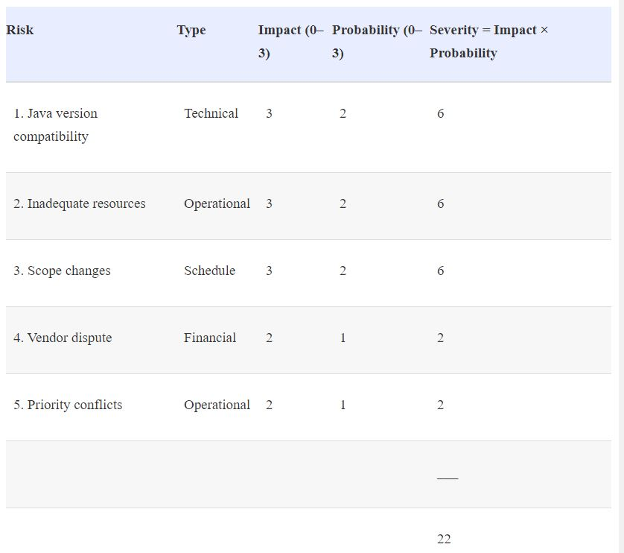
Risk Register- Another example
04/11/23
SE ZG544-S1-23-24 Agile Software Process

